Slide 1
Modules, MVC, Linters
JavaScript Training – Session 9
Diána Deregi Diana_Deregi@epam.com
March 26, 2020
CONFIDENTIAL | © 2020 EPAM Systems, Inc.

Slide 2

Diana Deregi
Software Engineer
I work at EPAM since August 2017 (2 years, 6 months, 28 days)
I have graduated from University of Debrecen (Computer Science BSc)

Slide 3

Agenda
1
Classes and modules (recap)
2
MVC
3
HMVC
4
Linters

Slide 4
Classes and modules quick recap

Slide 5
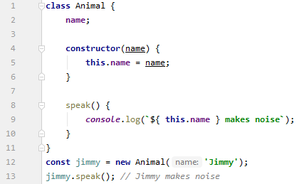
Classes - recap
class
constructor
methods
static methods
instance properties (static)
field declarations: public, private (#, limited support)

Slide 6
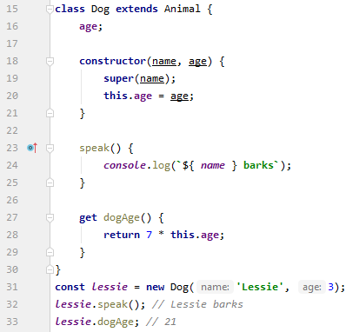
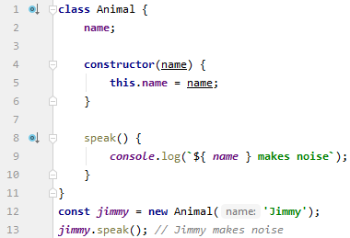
Classes - recap
extends, super()
getter, setter
https://developer.mozilla.org/en-US/docs/Web/JavaScript/Reference/Classes

Slide 7

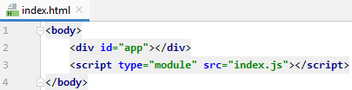


Modules - recap
Import as module in HTML
Export something (const, function, class...)
Import the exported const
It’s not needed to import constants.js in the HTML, since it’s imported in index.js. The browser will request it from the server.
Utility constants, functions, classes are collected in utils directory.
These are used in several pages/components in the application, imported when necessary.

Slide 8

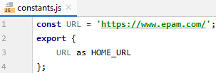

Modules - recap
Default export
Rename imports and exports with „as”
Creating a module object
https://developer.mozilla.org/en-US/docs/Web/JavaScript/Guide/Modules
The _ is an object, makes available all exports from lodash.
This module object effectively creates a namespace.
Notes:
aggregating modules - sub folders, export them from one file
dynamic module import
Typescript playground – visszautalni?!

Slide 9
Model-view-Controller MVC
Notes:
Felkészülés közben jöttem rá, hogy ez a csapatmunkáról is szól...

Slide 10

How I usually learn a new thing?
Have the million dollar idea!
Get into the documentation!
It looks easy. Let’s start coding!
Why it is not working?
How should I use it here?
Help me Google!
IT’S DONE! Look at it, it’s fantastic!
What if I work in a team?

Slide 11



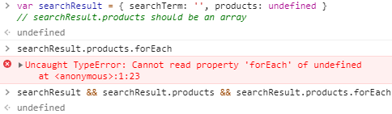
Working in a team is different
Coding standards to avoid holy wars
2 spaces? 4 spaces? tabs?
Naming conventions
Do not use Array constructor
Best practices (learnt from senior colleagues)
Empty list is truthy in condition
Pay attention to undefined errors
Notes:
Azon túl, hogy el kell viselni a többiek zsibbasztó vicceit egy nehéz nap végén...
Naming convention example: package: lowerCamelCase; classes: UpperCamelCase

Slide 12
Working in a team is different
Anti-patterns
Global context polluting
Inline scripts near the top of the <body>
Send XML in Ajax requests instead of JSON or HTML
Design patterns
Helps to minimize the impact of change.
Helps to understand the unfamiliar code.
Learn best practices, pitfalls from others.

Slide 13
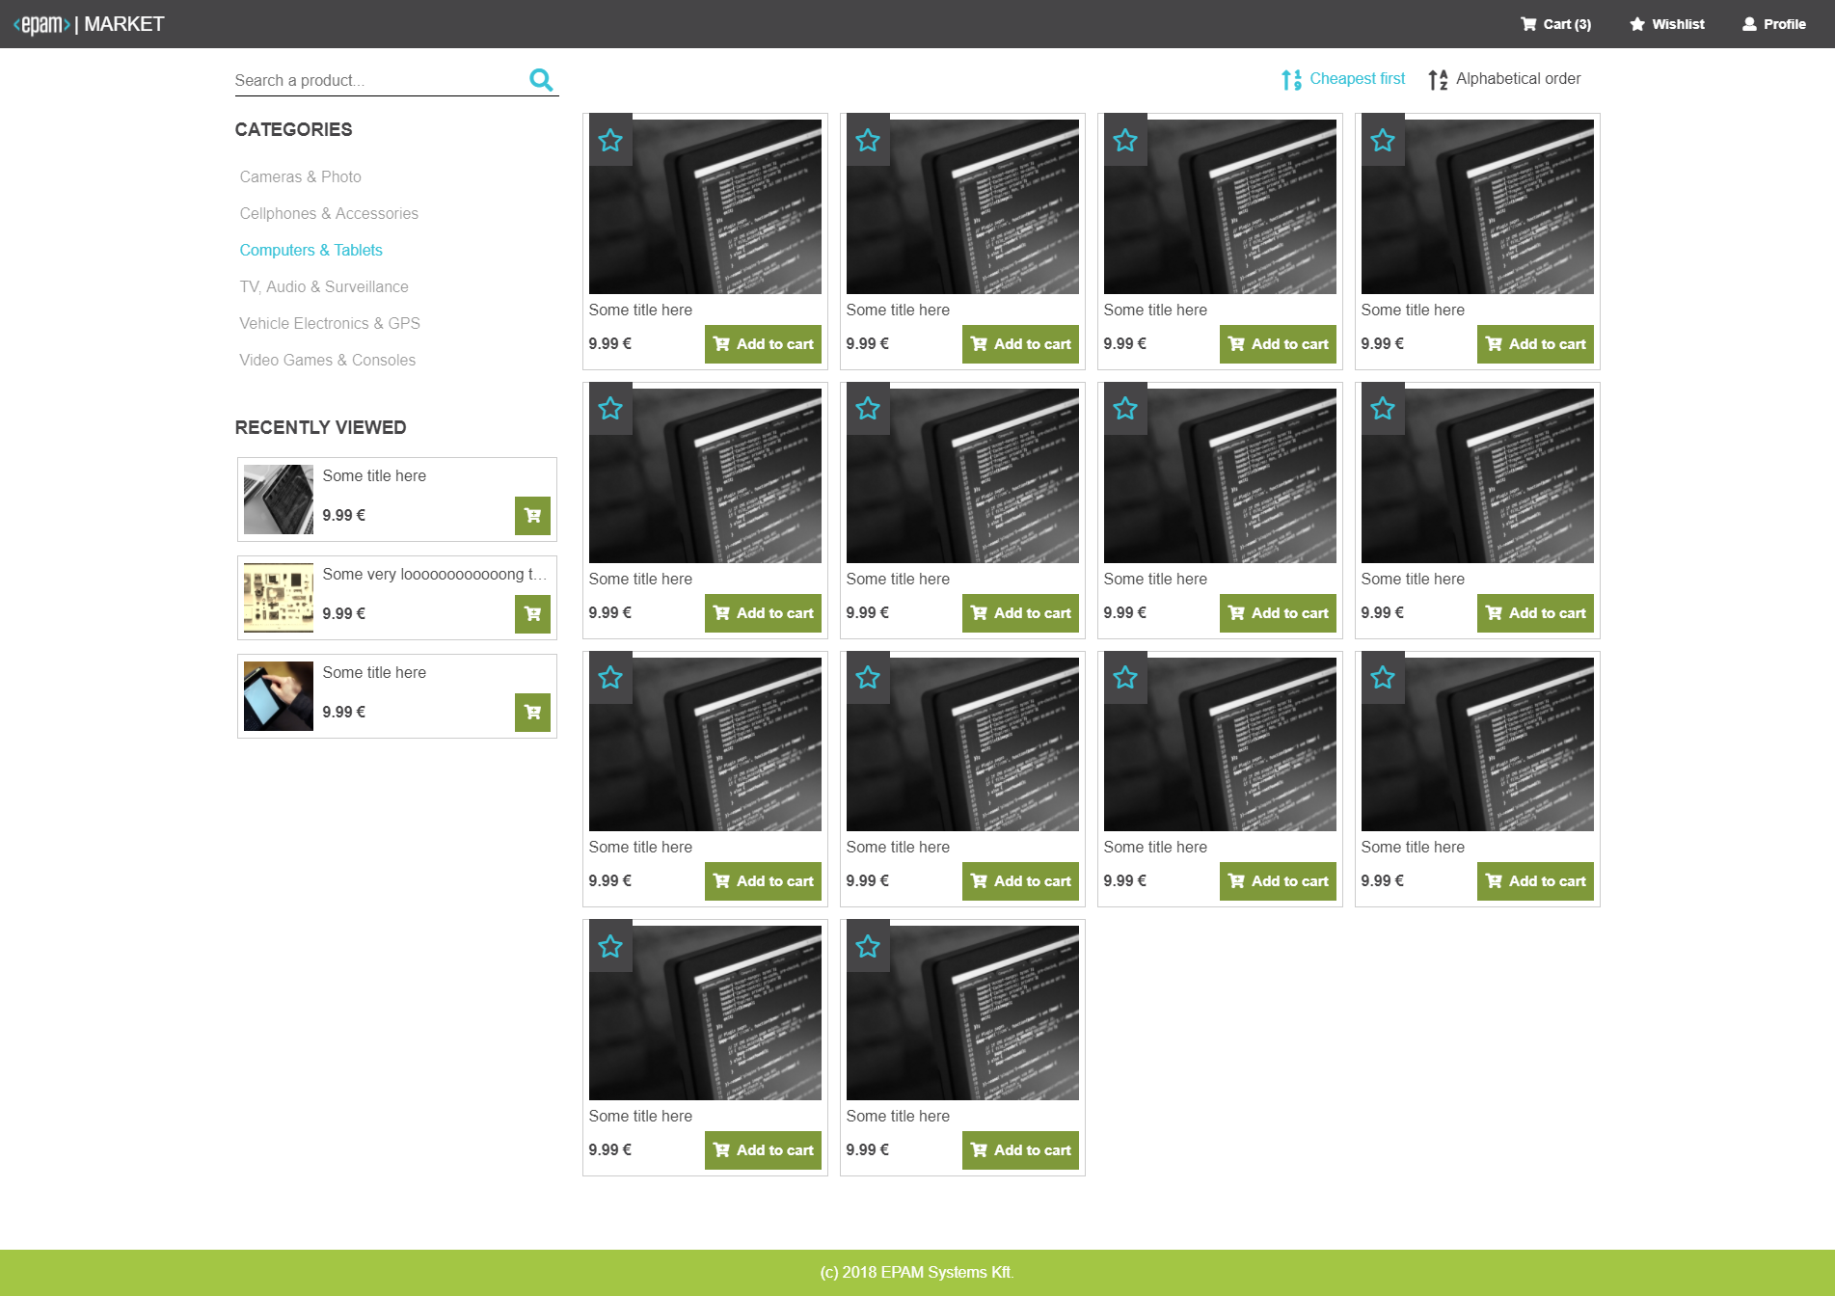
Model-View-Controller (MVC)
Separation of layers means that
the business entities (Model),
the presentation logic (View), and
the business logic (Controller)
are independent of each other.

Slide 14
Model
View
controller
Request data from the server
Transforms response into objects
Representation of the information
Connects the website with the user
Interprets the user actions
Converts input to commands for the model and view
Notes:
Converts input to commands for the model and view -> wishlist example

Slide 15
Controller
constructor(view, model)
Notify on user action
Modify data
View
Model
Notify on products loading
constructor(element, model)
constructor()
Render the HTML
Init listeners -> onAddToCart
getAllProducts()
addToCart(productId)
Get products on init

Slide 16
Exercise
Use the MVC design pattern while displaying the product items on the index page.
Work in this project: https://stackblitz.com/edit/js-mvc-start-here
Remember to:
Separate the layers
Use modules to separate the code
Initialize the view with the product items
Solution: https://stackblitz.com/edit/js-mvc

Slide 17
Model-View-Controller (MVC)
MVC is a design pattern
Helps to minimize the impact of change.
Helps to understand the unfamiliar code.
Learn best practices, pitfalls from others.
Gives only a theory, not an implementation
Frameworks, libraries implement MVC (or something similar)
MVP (Model-View-Presenter)
MVVM (Model-View-Viewmodel)

Slide 18
Hierarchical MVC HMVC

Slide 22
Hierarchical MVC (HMVC)
The application can be divided into several MVC based components For example: displaying the products items, the search bar, or the recently viewed items.
There is one component, which is on the top of the hierarchy and contains the other components.
The top component initializes the other components.
The communication between the MVC components are done via events, or the top level component.
Let’s check the project code, how it looks like in JavaScript...
Index Page Component
Search Component
Ordering Component
Categories Component
Product Items Component
Recently View Component

Slide 23

Homework
Implement the products page using the MVC.
Separate the layers as we did on the lecture
If necessary, build the page in hierarchy (HMVC)
Use modules to separate the code into files
Header does not need to be implemented, only the product displaying section
Get the productId from the URL (window.location is fine)
If you want to use the MVC in other way as in the exercise, feel free to choose that. In this case, write a proper description about the implementation, why you find that more useful.
If you haven’t done with the CSS homework yet, don’t worry, it won't matter in the evaluation of this homework, minimal CSS is enough. Pay attention to the MVC logic, HTML and JS.
Bonus question to think about (not part of the homework): How/Where we could use MVC, HMVC in the application? Implementation is not necessary, only some description or sample code.

Slide 24
linters

Slide 25
Linters
It is a tool which analyzes the source code to flag programming errors, bugs, stylistic errors, suspicious constructs.
Especially useful for interpreted languages like JavaScript because of lack of compiling phase.
It can be used as a simple debugger for common errors (undeclared variables) and hard-to-find errors such as heisenbugs (timing issues, optimized code/CSS).

Slide 26
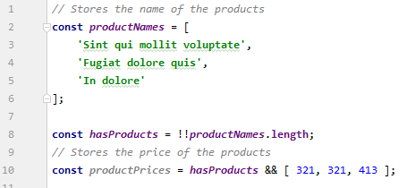
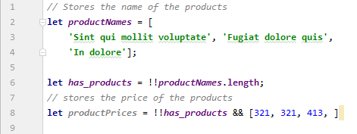
Some linter rule examples
Simple mistakes, but no error at the end
Unnecessary parentheses, semicolons, boolean casts...
Unused variables
Stylistic issues
DO
DON’T

Slide 27
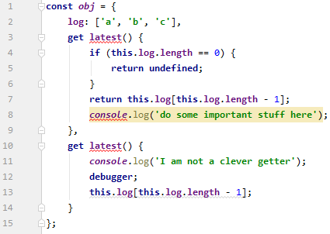
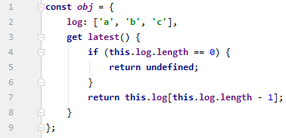
Some linter rule examples
Possible Errors
Missing return statement in getters Return statement in setters
Duplicated keys in object literals
Unreachable code after return, throw, continue, break
Remaining debugger
DON’T
DO

Slide 28
Linters
Benefits:
Less holy wars in pull requests on questions like single or double quotes, tab vs. spaces
Less comments like use const instead of let
Can focus on architecture, performance, security
Help newcomers to understand how to write code on the project
Reduces the senior developers’ time spent on teach the newcomers
Most of them offer plugins for IDEs

Slide 29
Linters
TypeScript linter TSLint - https://palantir.github.io/tslint/
CSS linter – CSS errors discovered by stylelint on the next slide stylelint - https://stylelint.io/
Node security linter NodeJsScan - https://github.com/ajinabraham/NodeJsScan
XSS – Reflected Cross Site Scripting - Never trust in user input
Missing security headers
Missing httpOnly In Cookie – JavaScript can access Cookies
X-Frame-Options (XFO) – Provides protection against Clickjacking attacks
Content-Security-Policy (CSP) – Eliminate several content injection vulnerabilities (cross-site scripting)

Slide 30
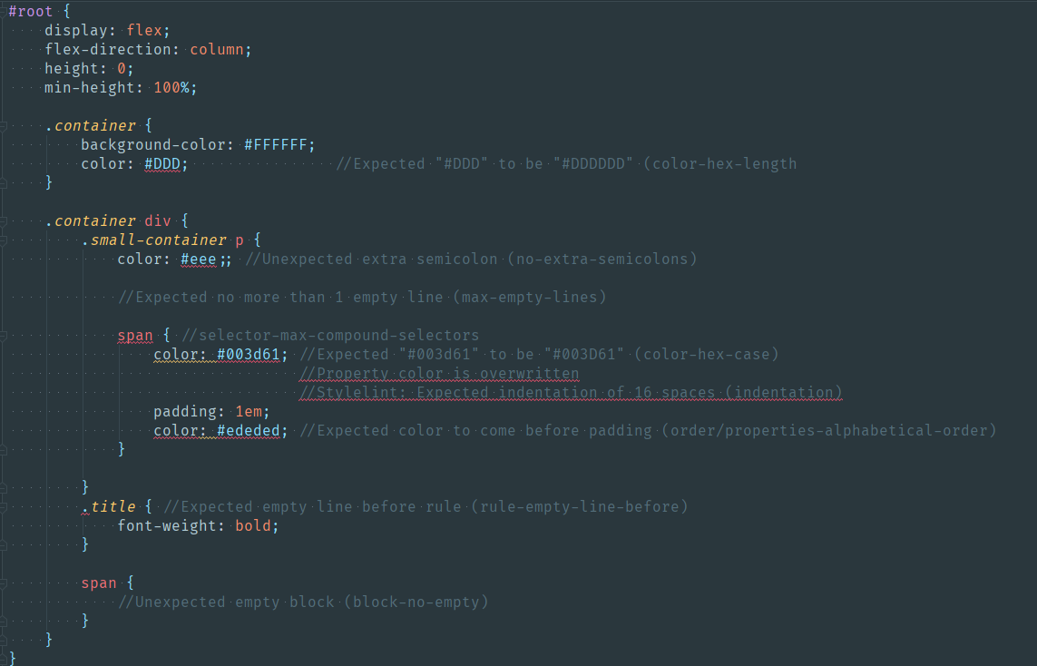

Slide 31
Homework
Get familiar with the documentation, setup ESLint ( https://eslint.org/ ) in your implementation of the MVC homework.
Use the required rules (listed on next slide) and fix errors in your code.
Optionally, if you find rules which looks useful, feel free to use them.
How to run ESLint?
Command Line Interface -> https://eslint.org/docs/user-guide/command-line-interface
Online interface -> https://eslint.org/demo
You don’t need to fix errors in files where you haven’t worked. You can disable ESLint in files which are provided by us and you haven’t worked in them. More info: https://eslint.org/docs/user-guide/configuring#disabling-rules-with-inline-comments
Notes:
Choose one way, and write it down in the email, when you send the homework!

Slide 32
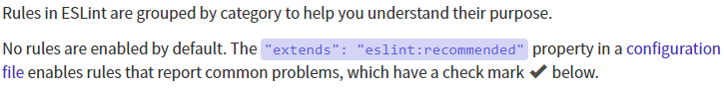

Homework
Rules to apply with ESLint:
Recommended configuration:
Some rules to add:
Ne legyen a template literal-nál látott változó értékének behelyettesítése normál stringeknél Példa kód, amit nem szabad írni:
Használjunk mindenhol === és !== operátorokat (== és != helyett)
Ne lehessen shadow változókat használni
Ne legyenek üres metódus blokkok
Ne lehessen az alert() metódust használni

Slide 33
Useful links
Modules https://developer.mozilla.org/en-US/docs/Web/JavaScript/Guide/Modules
Classes https://developer.mozilla.org/en-US/docs/Web/JavaScript/Reference/Classes
Build A Simple JavaScript App The MVC Way https://www.awwwards.com/build-a-simple-javascript-app-the-mvc-way.html
ESLint https://eslint.org/

Slide 34
Thank you for your attention! Any questions?
Diana_Deregi@epam.com

